Slide 1
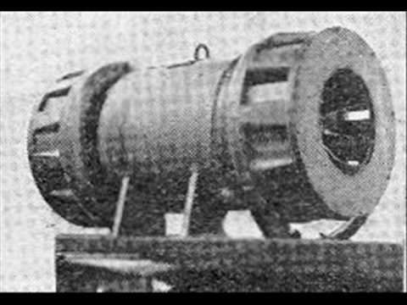

Children answer in speaker notes.
Press the sound! Oh no, quick hide under your table until it stops.

Slide 2

It’s time to evacuate!

Slide 3

1.What is evacuation?
2.Who would have experienced evacuation?
3.Why might people be evacuated? What happened to cause them to be evacuated?
Notes:
Hfwehbfewbfewuf

Slide 4


Looking at JUST the front cover….
What do you predict the book will be about and why?

Slide 5

Now look at the blurb….
Does this change your prediction? What do you think now?

Slide 6
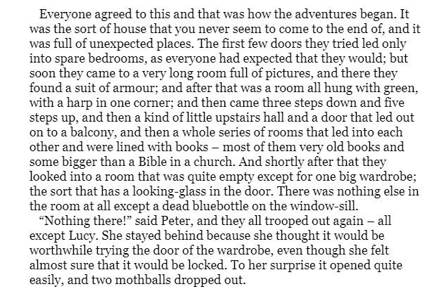

What does the old professor’s house look like? thinking about the clues from the text.

Slide 7
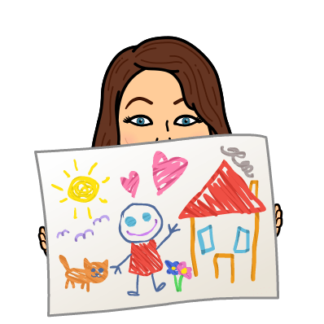
Draw what you can imagine the old professor’s house looks like, using the clues from the text. Send to Seesaw.

Slide 8
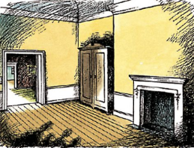
What do you predict is inside the wardrobe?

Slide 10
What did we predict might be inside the wardrobe?

Slide 11
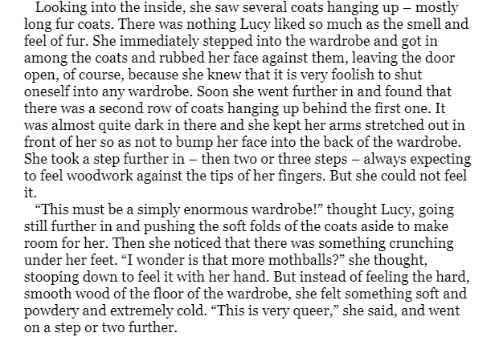

What do you think Lucy might be thinking and feeling as she ventures deeper into the wardrobe?

Slide 12
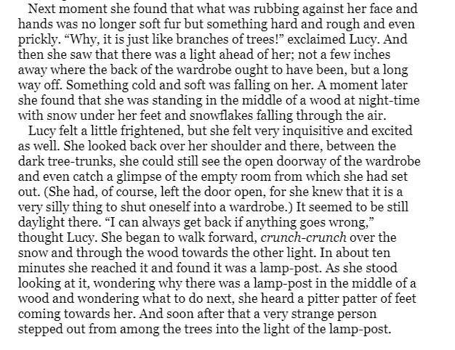

?
What has Lucy found at the other side of the wardrobe?
What can we figure out about this place already, from this text extract?

Slide 13
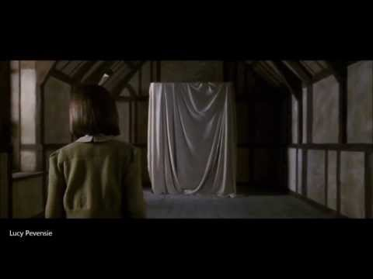


Slide 14
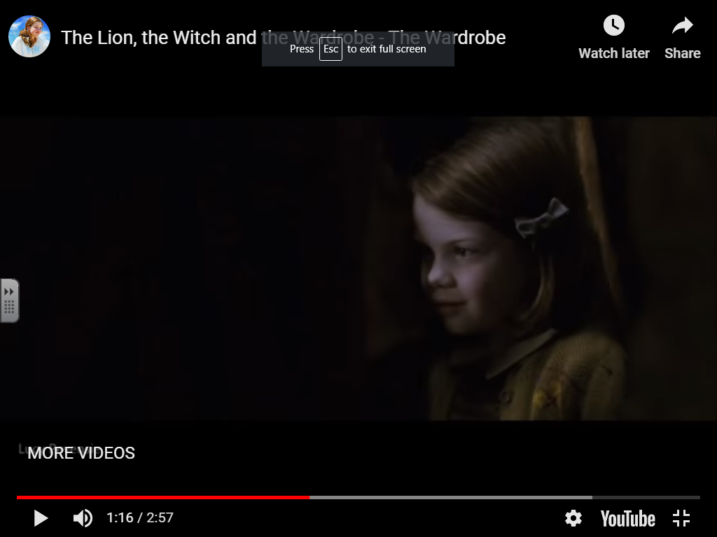
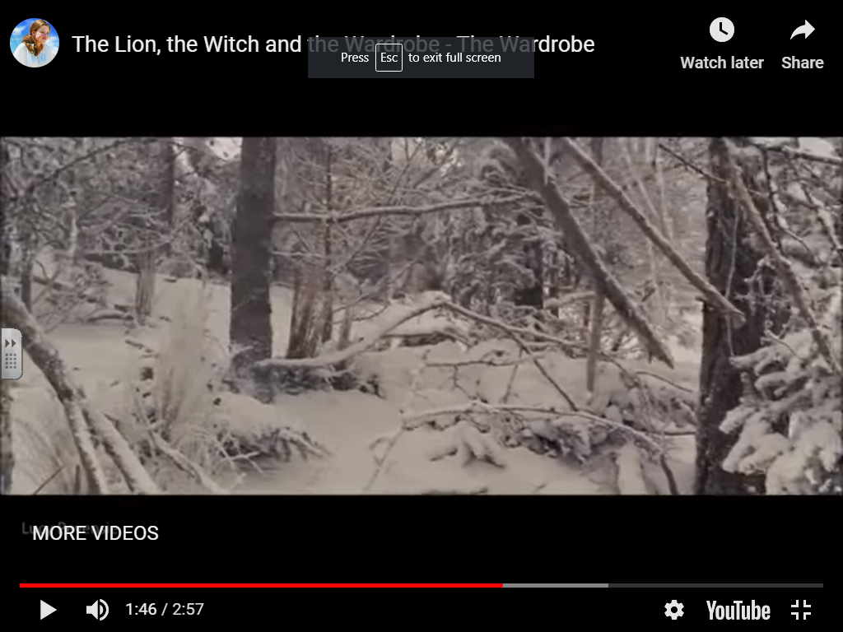
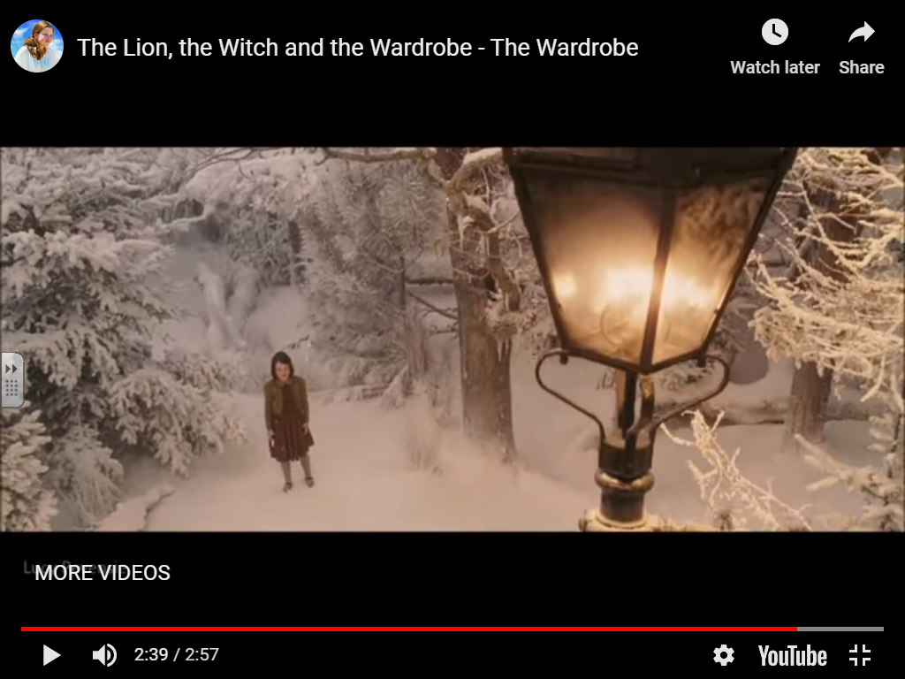
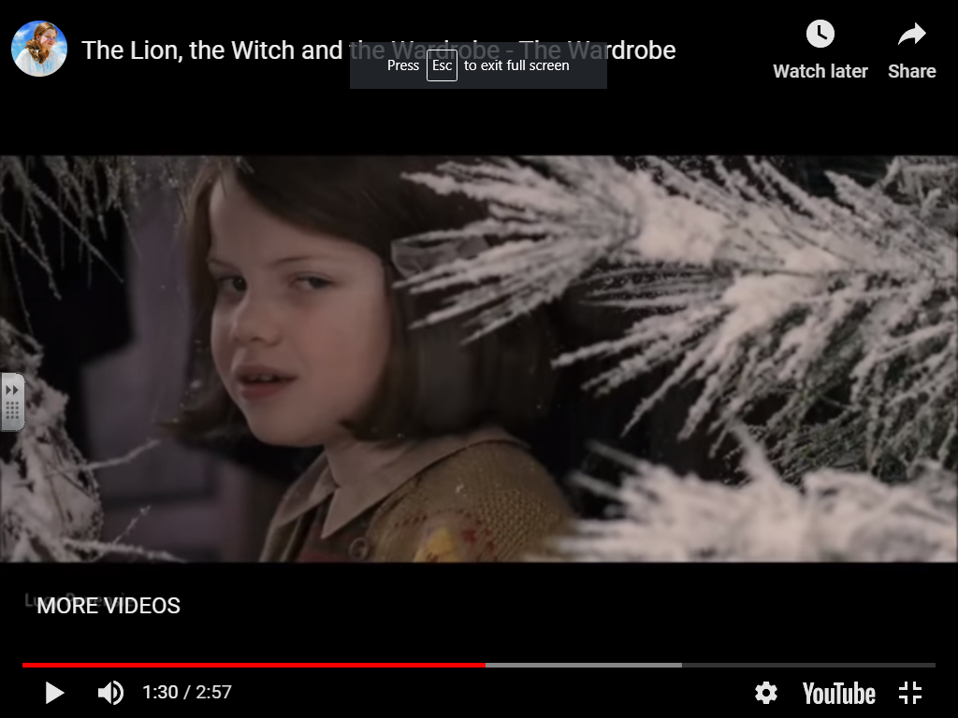
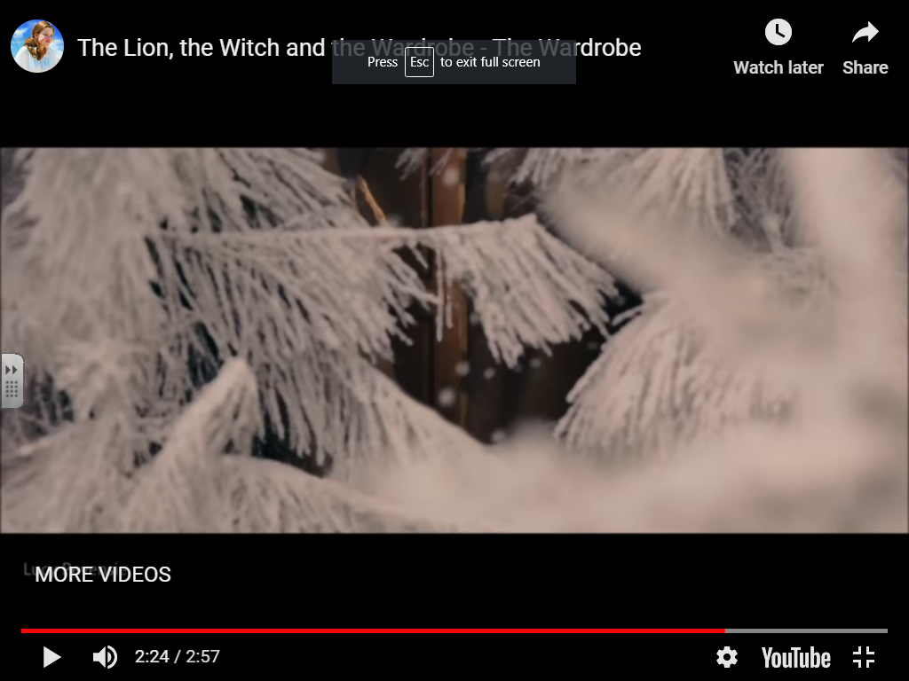
feeling?
thinking?

Slide 15
What is Narnia like based on the opening part of our book?

Slide 16
Teacher Help Video
Nouns | Adjectives | Verbs

Slide 17
Nouns | Adjectives | Verbs
Snow Lamp post Snow | White Bright Soft | Falling Shining Sparkled
The white snow was falling all around me as I walked further into Narnia.
Shining brightly, the lamp post stood out like a beacon in the dark forest.
Covering the ground like a blanket, the soft snow sparkled in the moonlight.

Slide 18
Nouns | Adjectives | Verbs
Lampost Snow trees | amber Cold Brown Prickly Tall, towering | Glowing Falling/ dancing Waving
Your go

Slide 19
The white snow was falling all around Lucy as she walked further into Narnia.

Slide 21

What do we know about Narnia so far?

Slide 22
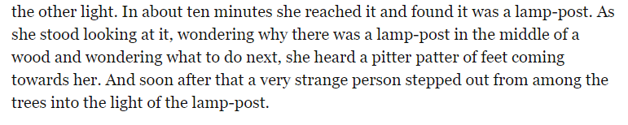
Who do you think the person is?
Is there anything unusual/magical about this person? What are the clues?
What do we know about the book already which might give us more clues?

Slide 23
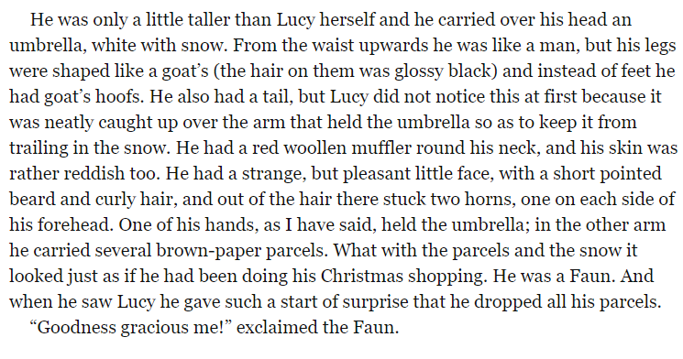

Draw a picture of the faun based on this description.
What do we know about his appearance?

Slide 24
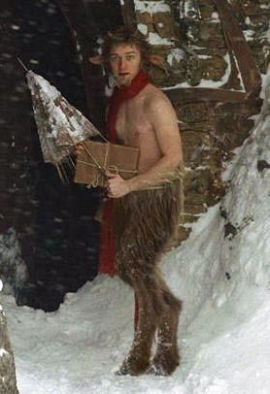
Appearance
Personality

Slide 25
Appearance
Personality
As he’s carrying presents, we assume (or guess) he’s very kind and generous.
He has a pleasant face, which shows he’s friendly.
He had black, glossy hairy goat legs.
Out of his hair, grew a horn either side of his head.
He was carrying an umbrella and parcels.
Behind him, he had a tail.
Around his neck, he was wearing a red scarf.
Instead of feet he had goat’s hooves.

Slide 26

What can we learn about his personality?
What clues are there?

Slide 27
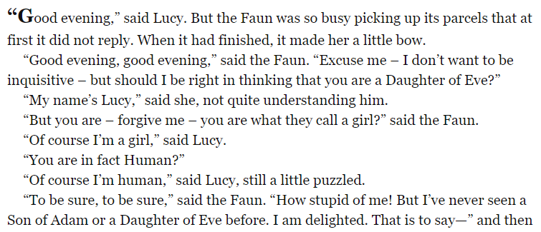
This small part of their conversation can reveal a lot about Narnia.
Is it normal to see humans in Narnia? How do we know?
Why do you think this is?

Slide 28
Lesson 4

Slide 29
Am I a good faun or a bad faun?
What do you think kids?
What do we know so far about Mr Tumnus?
Do we think he is a good character or not?
WHY?

Slide 30
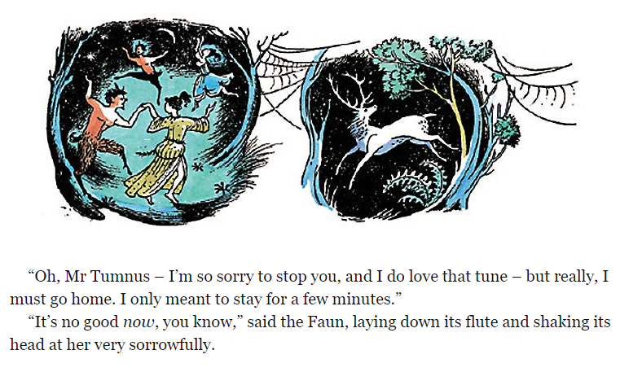

Slide 31
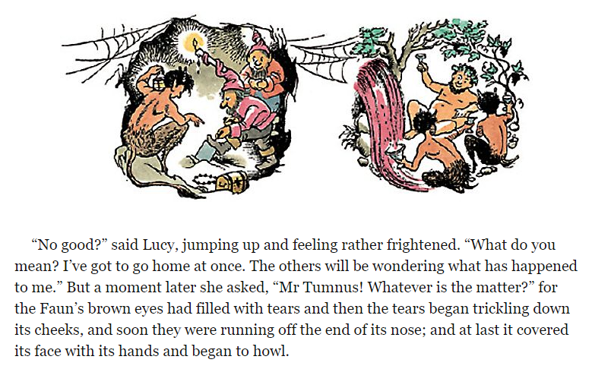

Slide 32
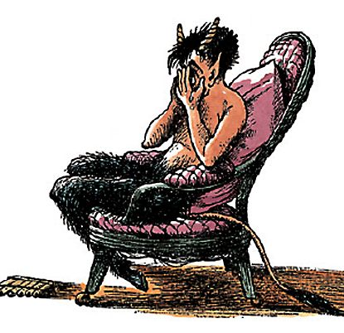
Why do we think Mr Tumnus is so upset?
What do we think has happened/is happening?

Slide 33
I have taken service under the White Witch!
Do we think this white witch is going to be a good or a bad character?
WHY?

Slide 34
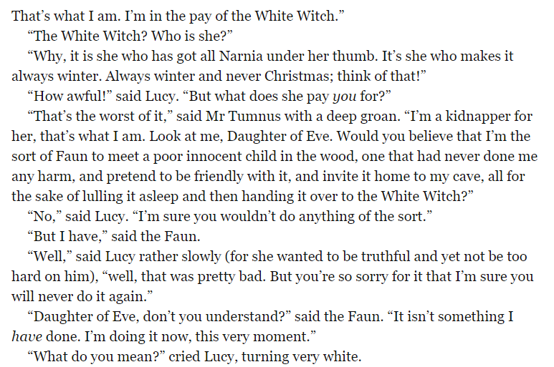
What can we learn here about the White Witch?

Slide 35
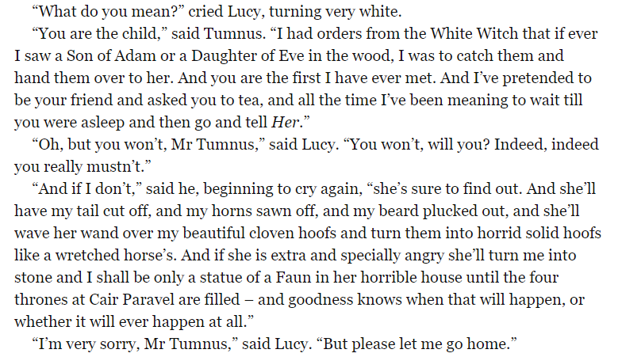
What is Lucy thinking?
What is Lucy feeling?

Slide 36
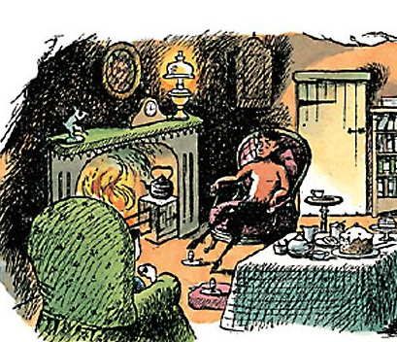
Lucy is in the middle of this fantastic adventure but she now knows it could be very dangerous for her to get home.
What might Lucy send, just in case she gets stopped by the white witch?

Slide 37

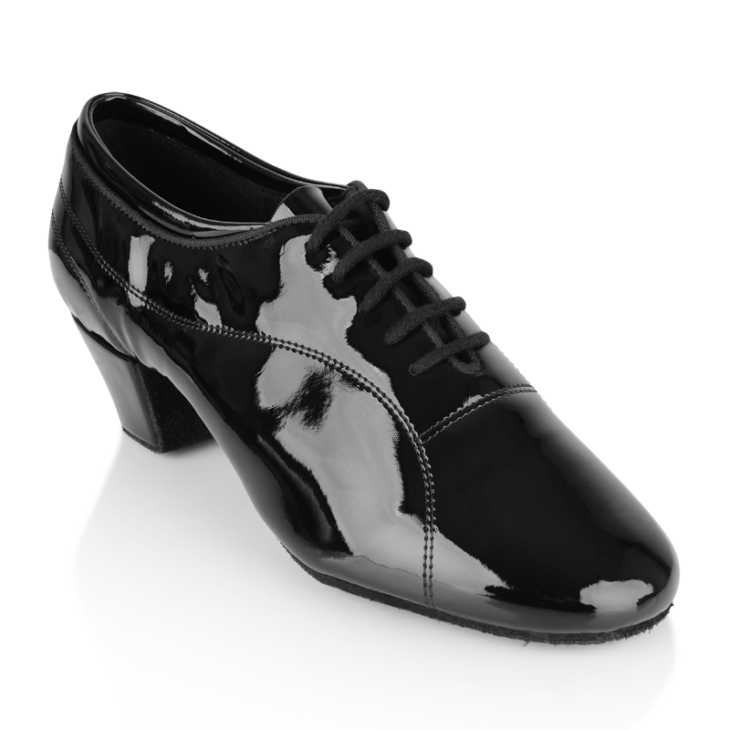
Put yourself in Lucy’s shoes, what things would need to be in your letter home?

Slide 38
What order would this info be in?

Slide 39
Well… Where do I start? Family, there is something I need to tell you...

Slide 40

W | Why are you writing?
E | Explain what has happened.
L | Location- Where are you, what is it like and who are you with there?
L | Let me tell you what is happening next/now/after.

Slide 41
12.11.19 L.C. Plan our recount letter home
W | Why are you writing?
E | Explain what has happened.
L | Location- Where are you, what is it like and who are you with there?
L | Let me tell you what is happening next/now/after.

Slide 42
Lesson 5

Slide 43


Look at the paragraphs on your chromebooks (in your Google classroom).
What can we find out from Lucy’s letter?
What makes it a WAGOLL?

Slide 44
W | Why are you writing?
E | Explain what has happened.
L | Location- Where are you, what is it like and who are you with there?
L | Let me tell you what is happening next/now/after.

Slide 45
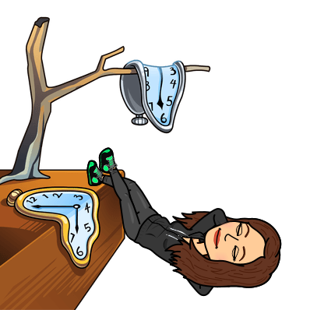
Discovered a wintery, snowy forest
Imagine you are Lucy, can you put these events in chronological order?
Met a strange creature, who was a faun called Mr Tumnus
Explored the inside of the wardrobe.
Saw a amber light, followed it to find a lampost
Notes:
Give children the events

Slide 46
Chronological order
Explored the inside of the wardrobe.
Discovered a wintery, snowy forest
Saw a amber light, followed it to find a lampost
Met a strange creature, who was a faun called Mr Tumnus

Slide 47

We can use adverbs of time to help us order events chronologically in a recount…
Can you brainstorm some examples?
Use the WAGOLL to help you too!

Slide 48

What do we need to include in our writing today?
Varied sentence openers
Who you are writing to?
Adverbs (time and manner)
Why you are writing?
Adjectives
Prepositions
What has happened so far?
Writing skills
Content

Slide 49
Y4 - Paragraph 1 and 2
I am writing to you to tell you about the unfamiliar place I find myself in. During our game of hide and seek, I was exploring the labrinth of spare rooms when I stumbled across an ancient, dusty but beautiful wardrobe. A mysterious feeling washed over me like a wave, I knew something was special about the old wardrobe, so I decided to look inside. As I crept deeper and deeper into the wardrobe, I felt an icy chill. The creaky floorboards suddenly morphed into crunchy, soft and white snow. Pushing the branches from my face revealed a bright beacon, which guided me to the middle of an enchanted forest. That was when I saw it. A bizarre figure was standing beneath a lone lamppost, I knew I had to make contact.

Slide 50


Time to have a go ...
Don’t forget…
Dear _____,
Introduce why you are writing
Explain what has happened so far
Vary your sentence openers
Use adjectives, adverbs, prepositions

