Slide 1


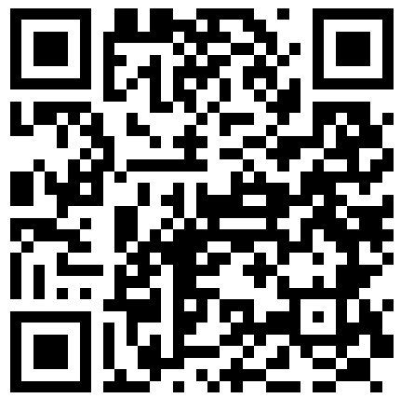


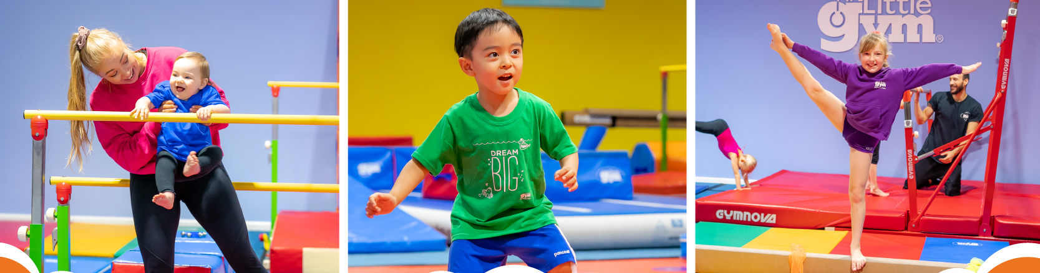
THE LITTLE GYM CAMPS FOR CHILDREN AGED 3-12 YEARS
Our next camps are in May Half-Term:
27th – 31st May
Scan below to learn more
or contact: 01904 307404
york@thelittlegym.co.uk

