Slide 1


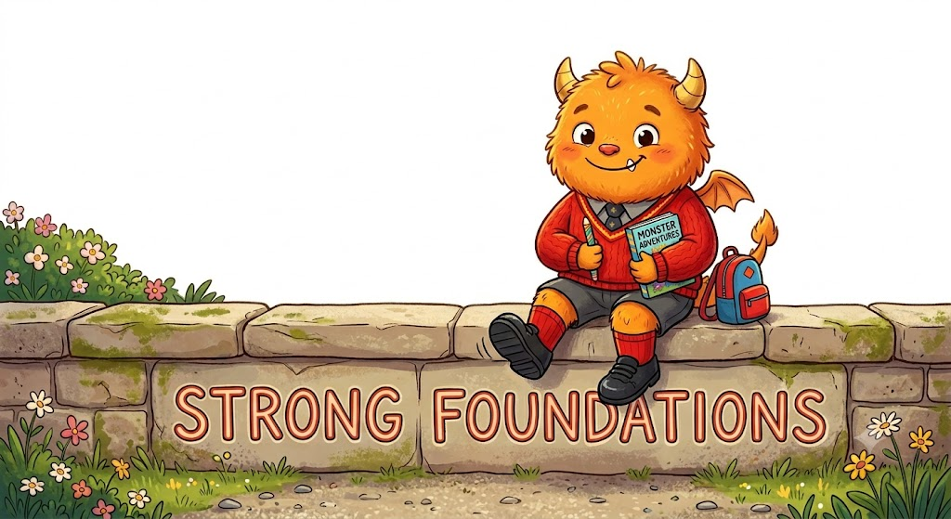
Hi, I’m ED and I want to see amazing Maths EVERY DAY at Haxby Road!

Slide 2

Bridges EDs
Uses number names and language
Recites some numbers up to 10
Sometimes matches numbers and quantity together

Slide 3
Tiny Steps EDs
Begins to say some numbers in the right order
Begins to notice some numerals
Makes simple constructions

Slide 4
Nursery EDs
Uses number names and language
Recites some numbers up to 10
Sometimes matches numbers and quantity together

Slide 5
Reception EDs
Uses marks, pictures, or objects to record thinking
Attempts to write numerals
Numbers written left to right
Adult modelling evident in books
Recording shows mathematical intent

Slide 6
Year 1 EDs
Numerals mostly formed correctly
One calculation recorded per line
Uses +, − and = symbols correctly
Pictures or tallies used to show thinking
Answers written clearly

Slide 7
Year 2 EDs
Uses +, -, x and ÷ symbols correctly
Uses squares or lines to support neatness
Clear spacing between questions
Working shown, not just answers

Slide 8
Year 3 EDs
Column addition and subtraction set out correctly
Numbers aligned accurately in columns
Beginning written layouts for multiplication and division
Diagrams and models clearly drawn and labelled
Presentation supports accuracy
KS2 always
Numerals formed correctly
Calculations laid out logically
Mathematical symbols accurate
Presentation supports understanding

Slide 9
Year 4 EDs
Formal written methods used consistently
One digit per square (where appropriate)
Steps shown clearly in multi-step problems
Mathematical symbols used accurately
Work is neat and well organised
Key Stage 2 always
Numerals formed correctly
Calculations laid out logically
Mathematical symbols accurate
Presentation supports understanding

Slide 10
Year 5 EDs
Chooses appropriate layout independently
Multi-step problems organised logically
Fractions, decimals, and percentages clearly recorded
Diagrams and graphs neat and labelled
Corrections made clearly
Key Stage 2 always
Numerals formed correctly
Calculations laid out logically
Mathematical symbols accurate
Presentation supports understanding

Slide 11
Year 6 EDs
Written work is systematic and fluent
Layout supports complex reasoning and algebra
Correct use of brackets, fractions, and decimals
Units included and written correctly
Work is easy to follow and self-checked
Key Stage 2 always
Numerals formed correctly
Calculations laid out logically
Mathematical symbols accurate
Presentation supports understanding

