Slide 1

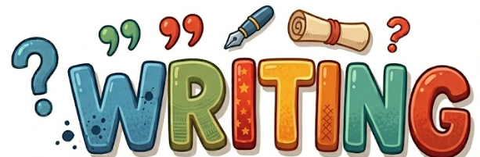
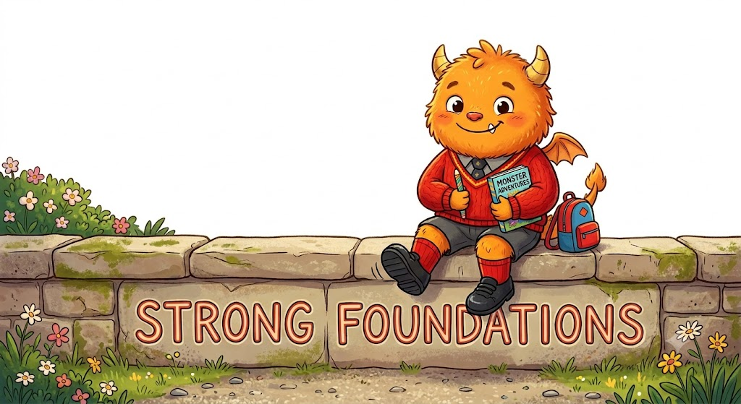
Hi, I’m ED and I want to see amazing writing EVERY DAY at Haxby Road!

Slide 2
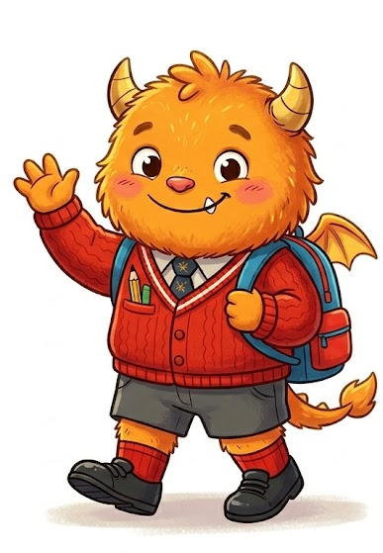
Bridges EDs
Experiments with marks.
Enjoys drawing and writing with different media.
Engages in the sensory experience of making marks.
Make marks, with the intention of conveying meaning.

Slide 3
Tiny Steps EDs
Make marks and talks about what they have drawn.
Enjoys drawing and writing with different media.
Begin to express their own experiences through mark making.
Use large movements with the upper body to help build on the foundations for fine motor.

Slide 4
Nursery EDs
Make marks and talks about what they have drawn.
Enjoys drawing and writing with different media.
Begin to express their own experiences through mark making.
Begin to recognise that letters represent sounds (E.g. Within their name) and begins to write them or produce symbols.

Slide 5
Reception EDs
Writes own name
Forms recognisable letters (mostly correctly oriented)
Uses letters to represent words
Writes simple words using phonics
Attempts simple sentences (may not be punctuated)
Writing is left-to-right
Some spaces between words
Children speak audibly, listen with support and begin to explain ideas. (Oracy)

Slide 6
Year 1 EDs
Writes simple, complete sentences
Capital letters and full stops used (not always consistently)
Leaves finger spaces between words
Words mostly phonetically plausible
Uses ‘and’ to join ideas
Common exception words sometimes correct
Letters correctly formed and mostly sized appropriately
Children speak audibly in simple sentences, listen with support, and begin to explain ideas and retell events with growing confidence. (Oracy)

Slide 7
Year 2 EDs
Writes a series of sentences on the same topic
Use capital letters and full stops
Use question marks and exclamation marks
Uses commas in lists
Some sentence variety (statements, questions)
Common exception words spelled correctly
Handwriting is legible and usually joined
Children project their voice clearly, use expanding sentences and topic vocabulary, explain simple reasoning, and take turns independently. (Oracy)

Slide 8
Year 3 EDs
Groups related ideas (emerging paragraphs)
Uses conjunctions (because, when, if, so)
Uses adjectives and expanded noun phrases
Uses adverbs and prepositions
Mostly consistent tense
Begins to use speech marks
Spelling of common words mostly accurate
Joined handwriting is consistent and legible
Children vary pace and intonation, use wider vocabulary to structure ideas, give reasons for opinions, and participate constructively in group talk. (Oracy)

Slide 9
Year 4 EDs
Paragraphs are clear and organised
Uses a comma after a fronted adverbial
Start sentences with an adverb, preposition or subordinating conjunction
Can punctuate direct speech with inverted commas
Correct tense throughout
Increasingly accurate spelling
Writing matches purpose (story, explanation, report)
I can change how I speak depending on who I’m talking to, use ‘expert’ words to explain my thinking (oracy).

Slide 10
Year 5 EDs
Writing shows cohesion across paragraphs
Uses varied sentence structures effectively
Uses a range of punctuation beyond basics (brackets, dashes, colons)
Ideas linked within and across paragraphs
Vocabulary is varied and precise
Controls tense and person
Mostly accurate spelling, including challenging words
Children present with controlled pace and expression, use ambitious vocabulary and persuasive language, evaluate ideas using evidence, and lead balanced discussions. (Oracy)

Slide 11
Year 6 EDs
Writing is sustained and well-structured
Clear awareness of audience and purpose
Confidently use a range of grammar and punctuation
Uses formal/informal tone appropriately
Uses passive voice and modal verbs where suitable
Paragraphs show cohesion
Spelling is accurate, including ambitious vocabulary (including years 5/6 spellings)
Children present confidently to varied audiences, speak with cohesion and sophistication, reason critically using evidence, and facilitate group talk with strong self-regulation. (Oracy)

